Slide 1
Chemical Bonding

Slide 2
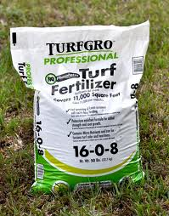
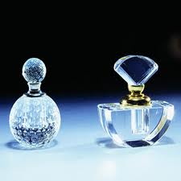
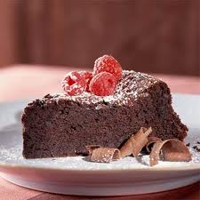
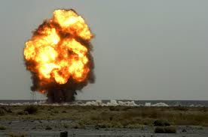
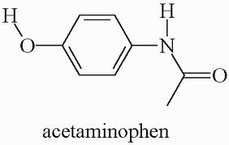
Calcium carbonate (limestone); Calcium phosphate
C₈H₈O₃ vanillin
NH₄NO₃
Medical

Slide 3
Ionic Bonding Vocabulary
Element- a substance that cannot be separated into simpler substances by chemical means; can be found on the periodic table
Ions- an electrically charged atom or group of atoms
Cation- a positively charged ion (metals); loses electrons
Anion- a negatively charged ion (non-metals); gains electrons
Ionic Compound- a compound composed of cations (metals) and anions (non-metals)

Slide 4
Ionic Bonding Vocabulary
Atom- the smallest representative particle of an element
Ionic Bonding- the formation of bonds between oppositely charged ions; the ions are formed from atoms that transfer one or more electrons
Valence Electrons- the outermost electrons of an atom; these electrons are used in bonding
Octet Rule- a rule stating that bonded atoms tend to have a total of 8 valence electrons (to be happy)
Superscript- a number, letter or symbol written above and to the side of the main text

Slide 5
Ionic Bonding Vocabulary *Words in red are honors only*
Subscript- a number, letter or symbol written below and to the side of the main text
Chemical Formula- a notation that uses chemical symbols with numerical subscripts to indicate the amount and types of atoms in a substance
Neutral Charge- when both charges are equal and opposite and cancels each other out
Net Charge- when the charges are not equal and opposite and result in an overall charge
Polyatomic Ion- A group of atoms that have an overall charge

Slide 6
Properties of Ionic Compounds
High melting and boiling points
Dissociates in solution
Conduct electricity when molten or in solution
Example:Sodium chloride has a melting point of 1480 °F

Slide 7
Charge
Each atom needs 8 valence electrons to be stable (octet)
The charge of an atom depends on how many electrons it gains or loses to have 8
Metals become positive (lose e-)- cations
Nonmetals become negative (gain e-)- anions
Group # | 1 | 2 | 13 | 14 | 15 | 16 | 17 | 18
# of Valence e- | 1 | 2 | 3 | 4 | 5 | 6 | 7 | 8
Charge | +1 | +2 | +3 | +/- 4 | -3 | -2 | -1 | 0

Slide 8
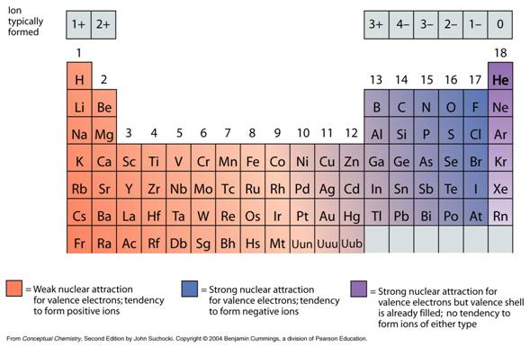
Charge

Slide 9
Ionic Bonds
Composed of ions, formed by transfer of electrons
A metal and a nonmetal (NaCl)
Overall charge must be zero! Na⁺¹ and Cl⁻¹ cancel out
Charges won’t always cancel, ex. Na⁺¹ and S⁻²
Na⁺¹ S⁻²
Na⁺¹______
+2 -2 = 0 Formula is Na₂S

Slide 10
Writing Ionic Formulas
Write the symbols of the two ions with the charges, putting the metal first
Criss-cross the charges and bring them down to be subscripts
Simplify and erase any “1”s
Ex. Magnesium and Nitrogen
Mg⁺² N⁻³
= Mg₃N₂

Slide 11
Transition Metals and Roman Numerals
Transition Metals, Tin and Lead have various charges. The charge must be given to you so you can write the formula
Roman Numerals= I, II, III, IV
Examples
Iron (III) Oxide = Fe⁺³ O⁻² = Fe₂O₃
Iron (II) Oxide = Fe⁺² O⁻² ⁼ FeO

Slide 12
Practice
Na¹⁺ , Cl¹⁻ Copper II Iodide
Mn²⁺ O²⁻
Li , O Titanium IV Nitride
Barium , Nitrogen
Magnesium, sulfur

Slide 13
Polyatomic Ions (Honors Only)
Ionic Compounds can contain a metal and a polyatomic ion (NaOH)
The rules for writing formulas is the same with polyatomics but make sure you put parenthesis around the polyatomic ion if you have more than one
Example 1: Al⁺³ SO₄⁻²
= Al₂(SO₄)₃ NOT Al₂SO₄₃
Example 2: Na⁺¹ C₂H₃O₂⁻¹ = NaC₂H₃O₂
Remember If charges cancel, just write the symbols.

Slide 14
Polyatomic Practice (Honors Only)
1. Ca , OH⁻
2. Rubidium phosphate
3 .Ammonium cyanide
4. Aluminum carbonate

Slide 15
Naming Ionic Compounds
Write the name of the first ion
Write the name of the second ion
Change the ending to –ide
In compounds containing polyatomic ions, do not change the ending when naming (honors only)
If the metal is a transition metal, be sure to put a roman numeral in the name to indicate the charge

Slide 16
Practice
NaCl 6. Mg(OH)₂
Li₂O 7. FeO
Ba₃N₂ 8. K₂SO₄
CuBr₂ 9. Ni₂(CO₃)₃
Mn₃P₂ 10. CoPO₄

Slide 17
Covalent Bonding

Slide 18
Covalent Bonds
Occur between 2 or more nonmetals
Formed from the sharing of valence electrons
Properties of Covalent Molecules
Low melting and boiling points
Dissolves in solution
Poor conductor of heat and electricity

Slide 19
Numerical Prefixes
Prefixes are used to indicate the number of atoms in the molecule (subscripts)
1 Mono- 6 Hexa-
2 Di- 7 Hepta-
3 Tri- 8 Octa-
4 Tetra- 9 Nona-
5 Penta- 10 Deca-

Slide 20
Naming covalent compounds
Write the name of the first element, and add a prefix
Write the name of the second element, add a prefix, and change the ending to -ide
Exceptions:
Never use “mono-” for the first element
Instead of “tetraoxide,” “pentaoxide,” it is “tetroxide,” “pentoxide,” etc.

Slide 21
Writing covalent formulas
Write the symbols, and get the subscripts from the prefixes
NO Criss-Cross

Slide 22
Name the following:
CO₂
PCl₃
P₂O₅
Write formulas for the following:
Chlorine dioxide
Sulfur hexafluoride
Nitrogen monoxide

Slide 23
VSEPR THEORY

Slide 24
8. VSEPR- “Valence shell electron pair repulsions theory”
VSEPR is a method you can use to determine the shape and polarity of a molecule.

Slide 26
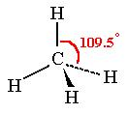
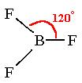
VSEPR overview
Each shape has a name
(you will have to know these)
Names of Shapes:
tetrahedral
trigonal pyramidal
Bent
Linear
trigonal planar

Slide 27
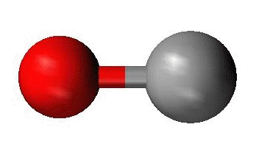
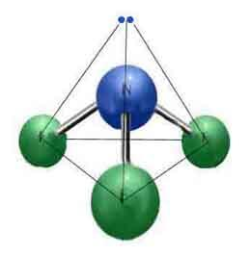
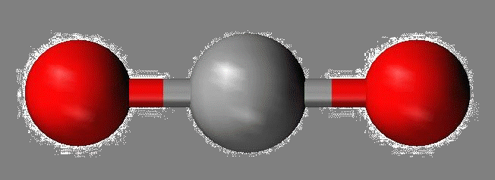
Models
Tetrahedral
Triangular Planar
Bent or V
Linear
Trigonal pyramidal

Slide 28
Lewis Structures- dot notation to show covalent bonds in molecules.
Place single atom in center.
If C is present, place it in center.
H and Halogens go on outside of molecule
8 dots around each atom. Move dots around if needed
Make symmetrical if possible
H, He, Li, Be and B will never get an octet (atoms are too small)

Slide 29
H₂O
Dot diagram Molecular class bond angle shape polarity
NH₃
Dot diagram Molecular class bond angle shape polarity

Slide 30
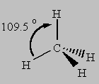
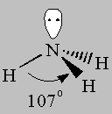
SHAPE
Molecule | Lewis Structure | Number of electron pairs
CH₄
NH₃
4
Tetrahedral
Trigonal Pyramidal
4
(3 shared
1 lone pair)

Slide 31
Molecule | Lewis Structure | Number of electron pairs
H₂O
SHAPE
Bent or V
4
(2 shared
2 lone pairs)
Linear
CO₂
2

Slide 32
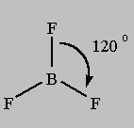
SHAPE
Molecule | Lewis Structure | Number of electron pairs
BeCl₂
BF₃
Linear
2
Trigonal Planar
3

Slide 33
INTERMOLECULAR FORCES

Slide 34
9. Intermolecular Forces – attractions between molecules; always weaker than ionic or covalent bonds between atoms.
Van der Waals Forces -2 Types
Dipole-Dipole (a dipole is a polar molecule); the positive end of one polar molecule attracts to the negative end of another polar molecule.
Dispersion forces – (weakest) occur between all molecules when the valence electrons happen to shift to one side of the molecule.
b) Hydrogen Bonds- attraction between a hydrogen atom in one molecule and a highly electronegative atom in another molecule.

Slide 35
10. Summary of Bond Strengths: Weakest to Strongest
Van der Waals, Hydrogen Bonds, Nonpolar Covalent, Polar Covalent, Ionic, Network Solids (diamond).

Slide 36
Hydrocarbons

Slide 37
13. Hydrocarbons- Organic compounds containing on the elements hydrogen and oxygen. Major use is as fuel.
3 Groups:
Alkanes (Single bonds)
Alkenes (Double bonds)
Alkynes (Triple bonds)

Slide 38
Prefixes for the first 10 straight chain hydrocarbons:
Meth- | 1 C atom | Hex- | 6 C atoms
Eth- | 2 C atoms | Hept- | 7 C atoms
Prop- | 3 C atoms | Oct- | 8 C atoms
But- | 4 C atoms | Non- | 9 C atoms
Pent- | 5 C atoms | Dec | 10 C atoms
Suffixes
-ane (Single bonds only)
-ene (double bond)
-yne (triple bond)

Slide 39
Ethane
Pentane
Ethene
Propene
Ethyne
Butyne

