Slide 1
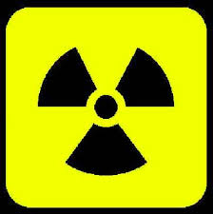
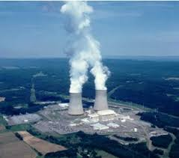
Nuclear Chemistry
LESSON 1: Radioactivity

Slide 2
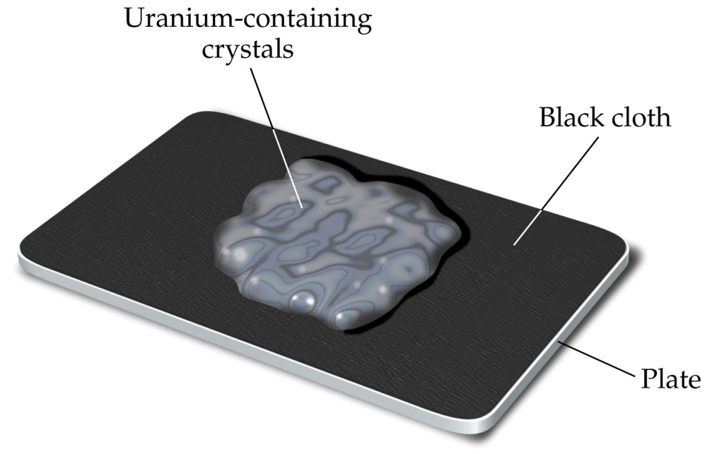
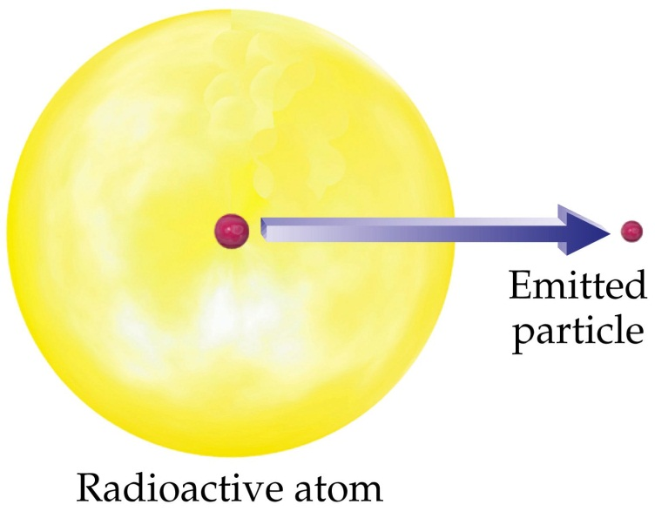
History of Radioactivity
Henri Becquerel - 1896 - uranium gives off x-rays
uranium produces an image on photographic film

Slide 3
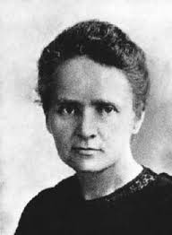
History of Radioactivity
Marie Curie - 1898 – with husband, Pierre, discovered polonium and radium, two radioactive elements

Slide 4
Isotopes
Atoms of the same element which have the same number of protons but different number of neutrons
The weighted average of all the isotopes is called the average atomic mass

Slide 5
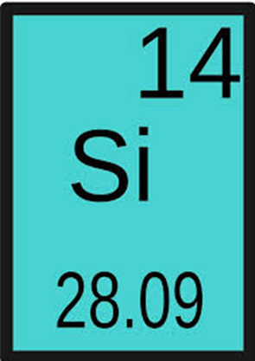
Average Atomic Mass (A)
Found on the periodic table
Number under the element symbol (always a decimal)

Slide 6
Calculating Average Atomic Mass
Instead of grams, we use atomic mass unit (amu)
Multiply abundance (decimal form) by mass number for each isotope, then add them together

Slide 7
Example
Hydrogen is 99% ¹H, 0.8% ²H, and 0.2% ³H. Calculate its average atomic mass.

Slide 8
You try it!
What is average atomic mass of Lithium if 7.42% exists as ⁶Li and 92.58% exists as ⁷Li?

Slide 9
You try it!
Magnesium has three naturally occurring isotopes. 78.70% of Magnesium atoms exist as Magnesium-24, 10.03% exist as Magnesium-25 and 11.17% exist as Magnesium-26. What is the average atomic mass of Magnesium?

Slide 10
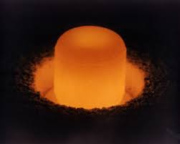
Radioactivity
Properties of radioactive elements:
Alter photographic film
Fluoresce in certain compounds
Produce an electric charge in the air
Damage the cells of most organisms
Radioactivity is the release of nuclear radiation in the form of particles and rays from a radioactive element

Slide 11
Radioactivity
What causes elements to be radioactive?
When the “binding energy” that holds the nucleus together is not strong enough, it breaks apart.
Often caused by having an excess number of neutrons
All elements have at least one radioactive isotope
All isotopes of elements with atomic numbers >83 are radioactive

Slide 12
3 Types of Radiation
Alpha particles - nucleus of a helium atom
2 protons and 2 neutrons
Weakest type, can be stopped by a piece of paper
$${}_{2}^{4}{He}$$

Slide 13
3 Types of Radiation
Beta particles - an electron
Formed inside the nucleus when a neutron breaks apart
Can be stopped by a thin piece of metal or a thick piece of wood
$${}_{−1}^{0}e$$

Slide 14
3 Types of Radiation
Gamma ray - an electromagnetic wave of very high frequency and short wavelength
Carry a lot of energy
Can be stopped by several cm of lead or several feet of concrete
γ

Slide 15
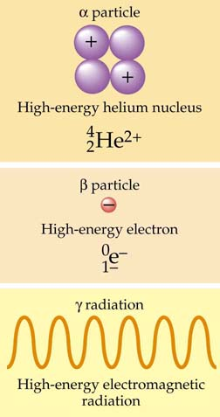
Figure 4.4: The components of α rays, β rays, and γ rays.
© 2003 John Wiley and Sons Publishers

Slide 16
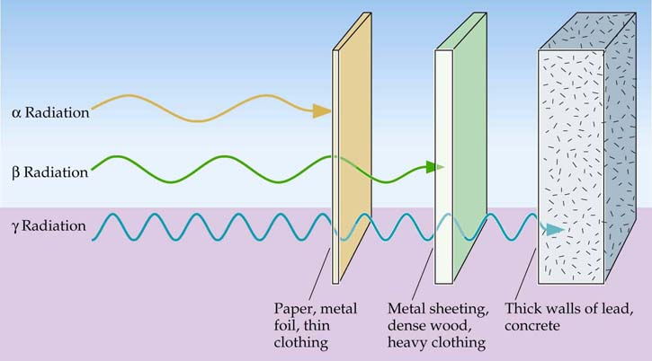
Figure 4.2: The penetrating power of radiation.
© 2003 John Wiley and Sons Publishers

Slide 17
Nuclear Chemistry
LESSON 2: Radioactive Decay

Slide 18
Radioactive Decay
An unstable nucleus can become stable by undergoing Radioactive Decay

Slide 19
Half-life
The amount of time it takes for ½ of the atoms in a sample to decay
“exponential decay”
Initial Amount
1st Half -Life
2nd Half -Life
3rd Half -Life
4th Half -Life

Slide 20
Half-Life

Slide 21
Half-Life
For example, suppose you have 10.0 grams of strontium – 90, which has a half life of 29 years. How much will be remaining after x number of years?
You can use a table:
# of ½ lives | Time (Years) | Amount Remaining (g)
0 | 0 | 10
1 | 29 | 5
2 | 58 | 2.5
3 | 87 | 1.25
4 | 116 | 0.625

Slide 22
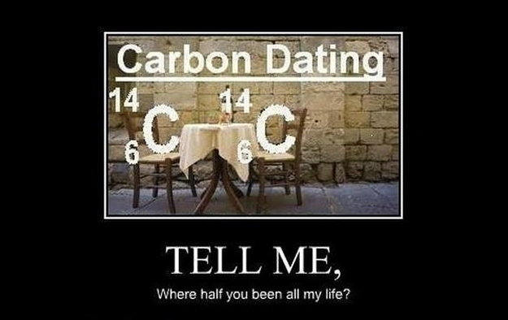

Slide 23
Half-Life
Example 1:
If gallium – 68 has a half-life of 68.3 minutes, how much of a 160.0 mg sample is left after 1 half life? ________
3 half lives? __________

Slide 24
Nuclear Chemistry
LESSON 3: Nuclear Reactions

Slide 25
Fission
The splitting of a large nucleus into two smaller nuclei
Releases of energy.
Used in nuclear power plants, nuclear bombs, and nuclear powered submarines and aircraft carriers (always at high temperatures).
Type of nuclear reaction that occurs on the sun and other stars.
The mass of the products is less than the mass of the reactants.
The lost mass is converted into energy. (E=mc²)

Slide 26
Fusion
The combining of two small nuclei into one larger nucleus
Releases more energy than fission
Powers the sun (and all other stars), and hydrogen bombs (the most powerful weapon ever made)
The mass of the products is less than the mass of the reactants.
The lost mass is converted into energy. (E=mc²)

