Slide 1
PERIODIC TRENDS

Slide 2
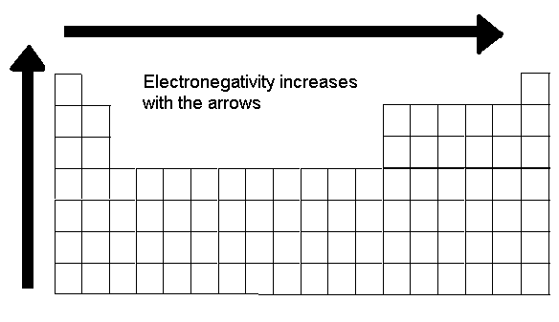
Electronegativity
Definition: The ability of an atom to attract an electron.
Trend Statement: Electronegativity Increases as you go up a group and across a period.
Why: As you go across the period and up the group, the atomic radius decreases. The electrons are closer to the nucleus, causing a strong attraction between the protons and the electrons.

Slide 3
Which is Greatest?
Li or B?
K or Ca
Rb or Ag?
Al or S?
Al or Ga?

Slide 4
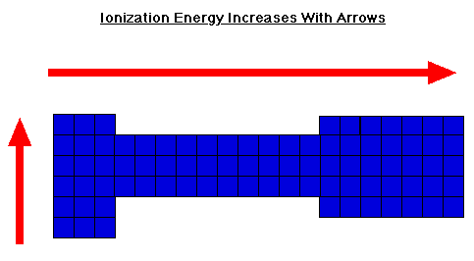
Ionization Energy
Definition: The energy required to remove the outermost electron from a neutral atom
Trend Statement: Ionization Energy Increases as you go up a group and across a period.
Why: As you go down the group, the atomic radius increases. There is a larger distance between the protons and the electrons making it easier for the electrons to be removed since there is no attraction.

Slide 5
Which is Greatest?
Li or Cs?
K or Rb?
Rb or Ag?
Al or Ga?
Ge or Ga?

Slide 6
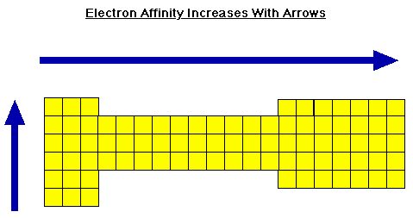
Electron Affinity
Definition: The energy given off when a neutral atom gains an extra electron.
Trend Statement: Electron Affinity Increases as you go up a group and across a period.
Why: Because electrons added to the energy levels become closer to the nucleus causing a strong attraction between the protons and the electrons.

Slide 7
Which is Greatest?
Li or B?
K or Ca
Rb or Ag?
Al or S?
Al or Ga?

Slide 8
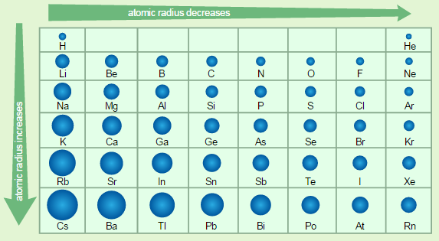
Atomic Radius
Definition: The size of the atom
Trend Statement: Atomic radius increases as you go down and group and decreases as you go across the period.
Why: The number of energy levels increases as you move down a group as the number of electrons increases. As you go across a period, electrons are added to the same energy level and become closer to the nucleus causing a strong attraction between the protons and the electrons.

Slide 9
Which is Greatest?
Li or Be?
K or Ti
Po or S?
In or Ga?

Slide 10
Ionic Radius
Definition: Size of the an ion.
Anions (negative ions) are larger than their respective atoms.
Why: Electrons outnumber protons; the protons cannot pull the extra electrons as tightly toward the nucleus.
Cations (positive ions) are smaller than their respective atoms.
Why: Protons outnumber electrons; the protons can pull the fewer electrons toward the nucleus more tightly.

Slide 11
Which is Greatest?
Li or Li+?
Ca²⁺ or Ca
Cl⁻or Cl?
S²⁻ or S?
N or N³⁻?

Slide 12
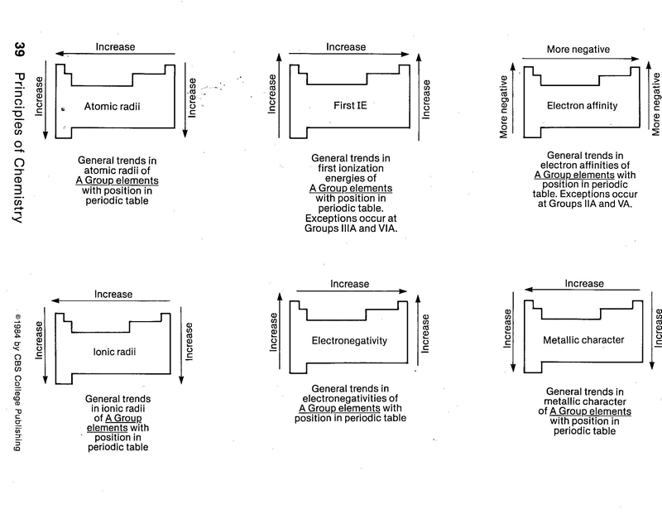
Periodic Trends

